Slide 1
Forms of Government

Slide 2
Outline
Aristotle's Classification of Government
Forms of Government
Democracy
Authoritarianism
Totalitarianism
Monarchy
Forms of Government
Parliamentary
Presidential

Slide 3
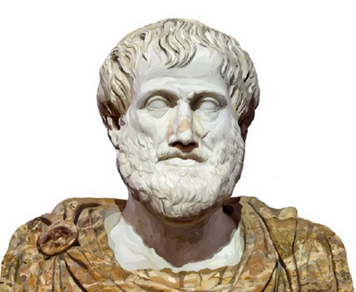
Aristotle’s Classification of Government

Slide 4
Aristotle’s Six Types of Government
Aristotle’s classification is based on two principles:
Number of person who exercise supreme power
The ends they seek : self interest or benefit of the community
When the rulers aimed at the good of the community, the state would be pure (normal)/ideal form of the state
When the rulers in such a state became selfish, the state would be called perverted/corrupted state.
See the next slide

Slide 5
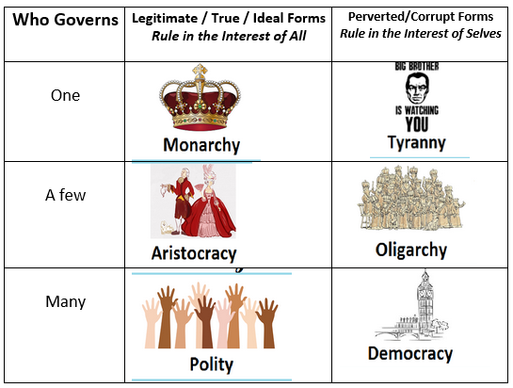
Aristotle’s Six Types of Government

Slide 6
Aristotle’s Six Types of Government
Monarchy – Tyranny
Monarchy: if sovereignty resides in one person. and perverted form of
Monarchy is Tyranny.
Aristocracy – Oligarchy
Aristocracy: if sovereignty resides in small minority of the population.
If this small minority uses the sovereignty for its own selfish end, it is oligarchy.
Polity – Democracy
If the sovereign power resides in a large proportion the population, it is polity. Its perverted form is Democracy.

Slide 7
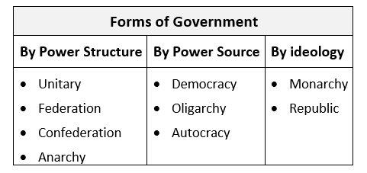

Slide 8

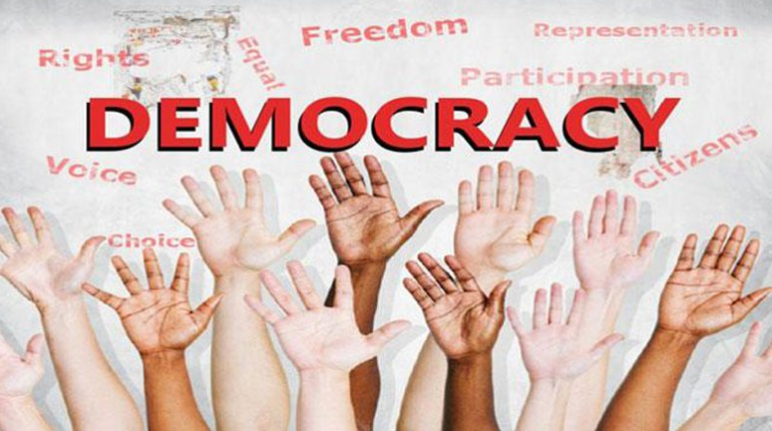
Democracy

Slide 9
Democracy
Democracy came from Greek ‘demos’ (the people) and ‘Kratos’ (power), thus, democracy means - ‘Power of the People.’
Democracy is the form of government in which the sovereign power of the state is in the hand of the people and the people are the sources of the state power and the people take part in the government directly or through their representative.

Slide 10
Democracy
Direct Democracy
Practiced in Greek city-states in which people or the citizens would directly take part or participate in the governance of the state.
Representative Democracy
Representative democracy or indirect democracy is when people choose to vote for who will represent them in a parliament. This is the most common form of democracy found across the world.
Its emphasis lies on protecting the rights of not only the majority of the people in the state, but also the minorities.
Most of the representative democracies of the world consider themselves to be liberal democracies.

Slide 11
Democracy
Liberal Democracy
is a form of government in which representative democracy operates under the principles of liberalism.
It is characterized by fair, free, and competitive elections between multiple distinct political parties, a separation of powers into different branches of government, the rule of law in everyday life as part of an open society, and the protection of human rights and civil liberties for all persons.
To define the system in practice, liberal democracies often draw upon a constitution, either formally written or uncodified, to delineate the powers of government and enshrine the social contract.

Slide 12
Liberal Democracy
A liberal democracy is a form of democracy which emphasizes and protects individual freedom. Certain rights are viewed as inalienable, meaning they are intrinsic to the individual and cannot be transfered or revoked. This is usually accomplished through constitutional or

Slide 13
Authoritarianism
https://www.youtube.com/watch?v=n1tXjJobjfs
https://www.youtube.com/watch?v=Yu3HikdxJn0

Slide 14
Authoritarianism
In 1964, Juan José Linz, Professor Emeritus of Sociology and Political Science at Yale University, described the four most recognizable characteristics of authoritarian state as:
Limited political freedom with strict government controls imposed on political institutions and groups like legislatures, political parties, and interest groups
A controlling regime that justifies itself to the people as a “necessary evil” uniquely capable of coping with “easily recognizable societal problems” such as hunger, poverty, or violent insurgency
Strict government-imposed constraints on social freedoms such as suppression of political opponents and anti-regime activity
The presence of a ruling executive with vague, loosely defined and shifting powers

Slide 15

Authoritarianism
It is a system of government in which power is exercised by a small group with minimum input: i) family; ii) absolute monarch; iii) a social class; iv) elitist technocrats or top bureaucrats; v) a strong political party; vi) army in the wake of a military coup.

Slide 16
Authoritarianism
They do not attempt to control everything. Many economic, social, religious, cultural, and familial matters are left up to individuals. It does not interfere with the lives of the private citizens but it does not promote individual freedom;
Citizens do not participate in the governance of the country but they are expected to obey the government; It has democratic elements or institutions but they are mostly dysfunctional; so through democratic reforms the system can return to a democratic one

Slide 17
Modern Totalitarianism Vs Autocracies of the past
Due to the lack of communication and technology, the autocracies of the past did not have total control over their domain, and as such, could not interfere with the personal lives of the citizens; they remain largely indifferent to wishes of their subjects;
Whereas the modern totalitarianisms with the help i) of an efficient communication systems and technology insist on the mass participation of the citizens and try to generate enthusiasm for the success of the system; ii) with the help of modern electronic devices, the state is able to control communications and private activities and thereby regulate political life and thought; iii) through electronic data control it is able to coordinate and centralize the utilization of resources and thereby regulate economic life.

Slide 18
Totalitarianism

Slide 19
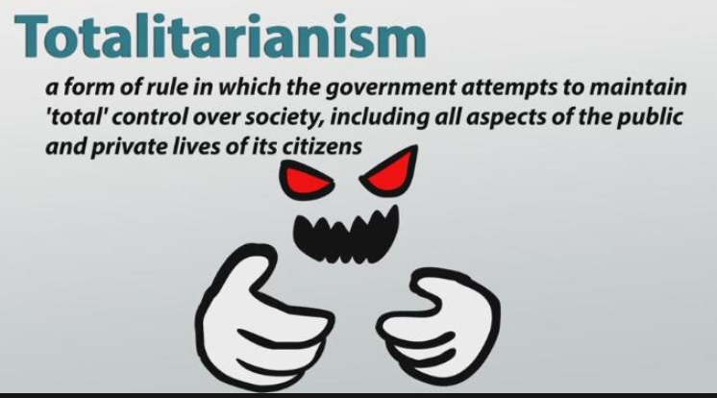
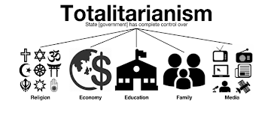

Slide 20
Totalitarian Government/Totalitarianism
This type of government emphasizes on total control, brainwashing, and worship of the state and its leader; it is a system of government in which one party holds all political, economic, military and judicial power.
The Party attempts to restructure society, to determine the values of the society, and to interfere in the personal lives of individual citizens in such a way as to control their preferences, to monitor their movements, and to restrain their freedoms;

Slide 21
Totalitarian Government/Totalitarianism
Severe economic, social, and political problems arose during and after World War I. Severe inflation, high unemployment, and a fear of communism spread throughout Italy, Germany, and Spain. Fascist leaders in Italy, Germany, and Spain exploited these hardships to gain popular support and rose to power in the 1920s and 1930s.
Totalitarian governments are characterized by one-party political systems that deny basic human rights. Totalitarian governments are also characterized by the use of secret police and repression.
The Japanese, the Germans (Hitler), and the Italians (Mussolini) pursued a policy of expansionism before World War II to gain natural resources.

Slide 22
Six Features of Totalitarianism
An All-Encompassing Ideology;
A Single Party;
Use of Terror and violence;
Organized Terror;
Monopoly of Communications;
Monopoly of Weapons;
Controlled Economy.

Slide 23
Strategies to Implement Totalitarianism
Examples of totalitarian regime strategies to gain control of the nation include:
Having a dictatorship
Employing only one ruling party
Rule through fear
Censorship of media
Propaganda in media, government speeches and through education
Criticism of the state is prohibited
Mandatory military sign up
Secret police forces
Controlling reproduction of the population (either in hopes to increase or to decrease)
Targeting of specific religious or political populations
Development of a nationalist party

Slide 24
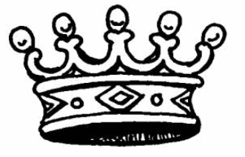
Monarchy

Slide 25
Monarchy was the most common form of government until the 19th century.
Monarchy is a form of government in which a single family rules from generation to generation. The power, or sovereignty, is personified in a single individual.
There are two main types of monarchy that differ based on the level of power held by the individual or family currently in power.
Absolute monarchy exists when the monarch has no or few legal limitations in political matters.
Constitutional monarchies, which are more common, exist when the monarch retains a distinctive legal and ceremonial role but exercises limited or no political power.
Example: constitutional monarchy that exists in the United Kingdom. Queen Elizabeth II is the head of state of the U.K. as well as monarch of fifteen other independent countries. She and the royal family have ceremonial roles but do not make up the laws that govern the people.

Slide 26
Forms of Government: Parliamentary, Presidential

Slide 27
